Slide 1
Python Course for Physicists (And everyone else!) Chunk 12: Scipy & Regressions
By Jonathan Bollig
08.10.2025

Slide 2
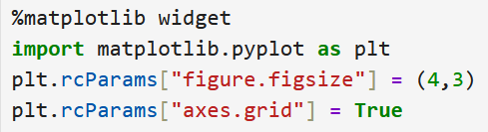
Matplotlib: rcParams
rcParams: Set style of plots for complete document:
Complete set of parameters here.

Slide 3
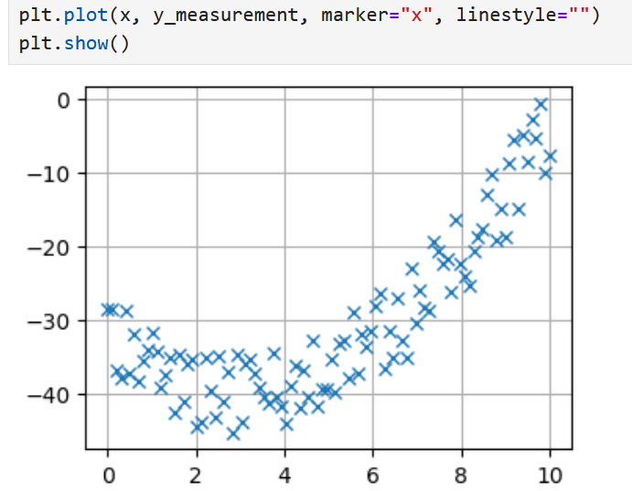
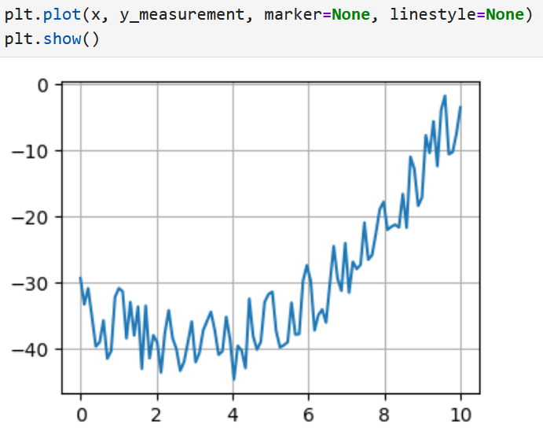
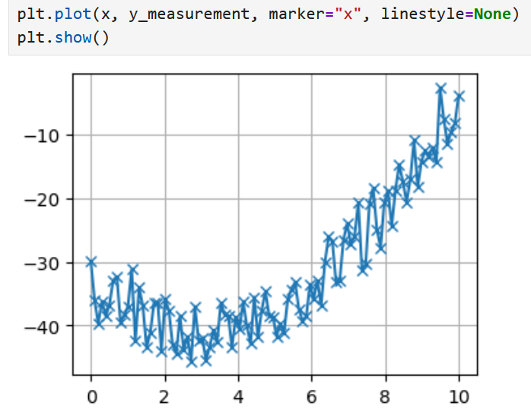
Live Coding: Visualizing Noisy Data
plt.plot(x, y, marker="x", linestyle="")

Slide 4
Finding the Function: Regression
Usually: We have an idea of the “nature” of our data. → Example shown: “looks like a quadratic function”
But: We don’t know the constants describing the polynomial
Two options:
np.polyfit(x, y, order) → returns the coefficients
General function definition → scipy.optimize.curve_fit(…)

Slide 5
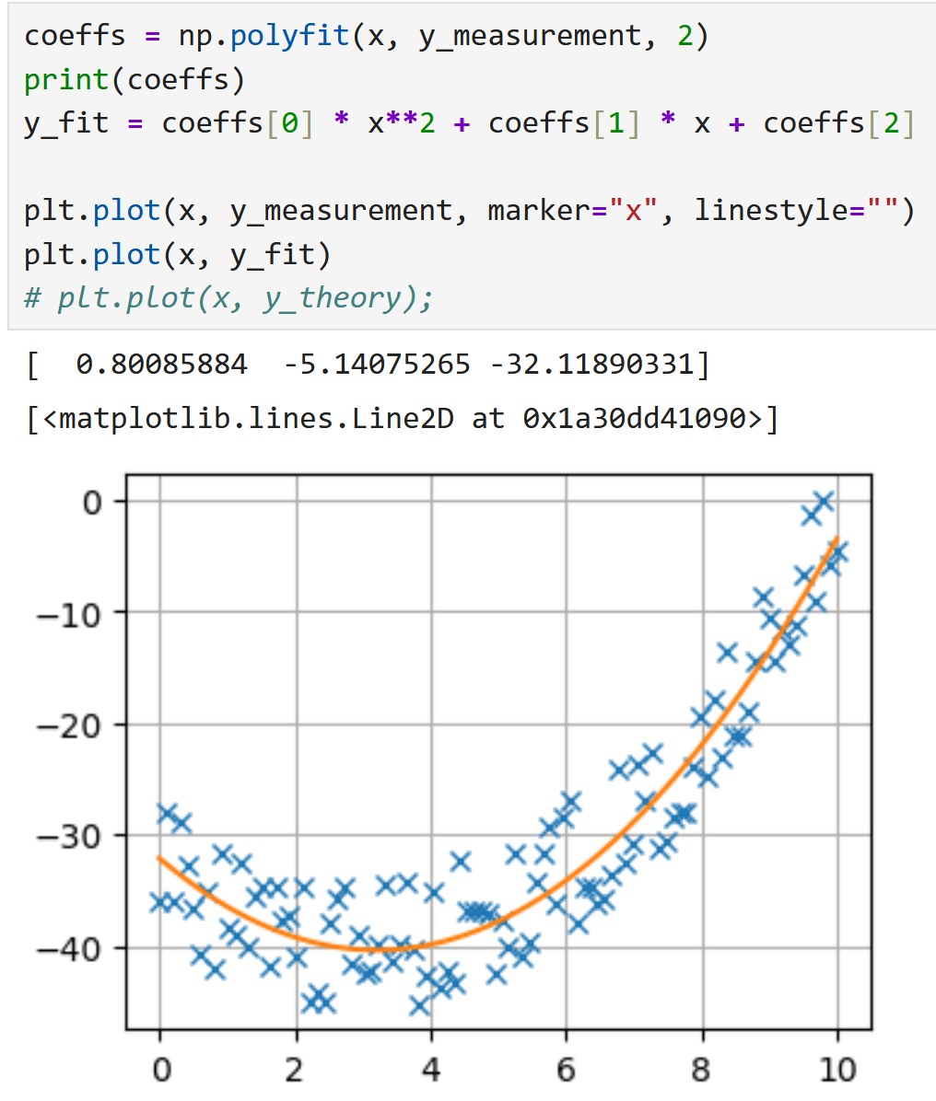
Live Coding: Numpy polyfit
polyfit finds coefficients.
Coefficients can be used to create a fitted function
Plot the fitted function

Slide 6

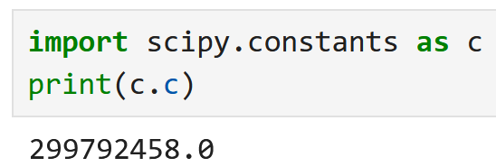
scipy (constants)
scipy → scientific python
Tons of useful functions
One example: scipy.constants:

Slide 7
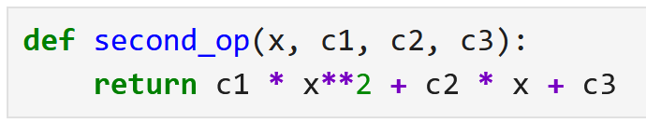
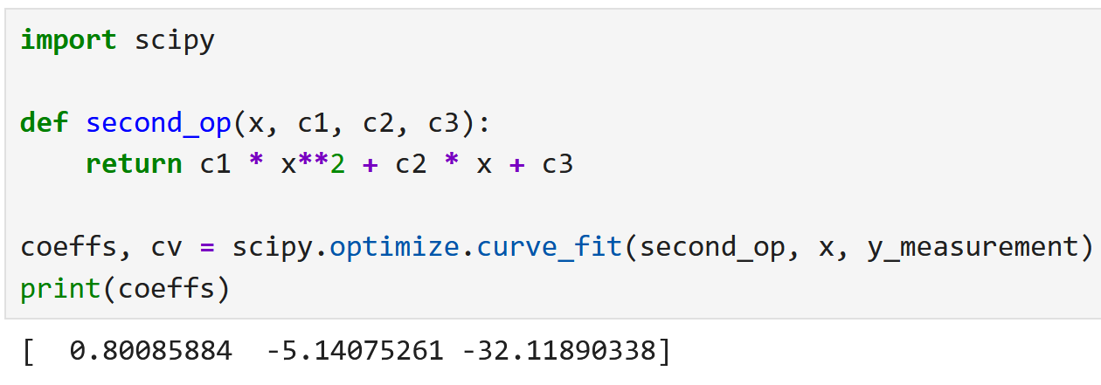
Live Coding: scipy curve_fit
1. x
2. parameter
Need to create a python function, that describes our mathematical function → Order matters
Create coefficients & covariance
Covariance can be used to calculate confidence intervals
If convergence fails: Give initial guess with optional p0 parameter

Slide 8
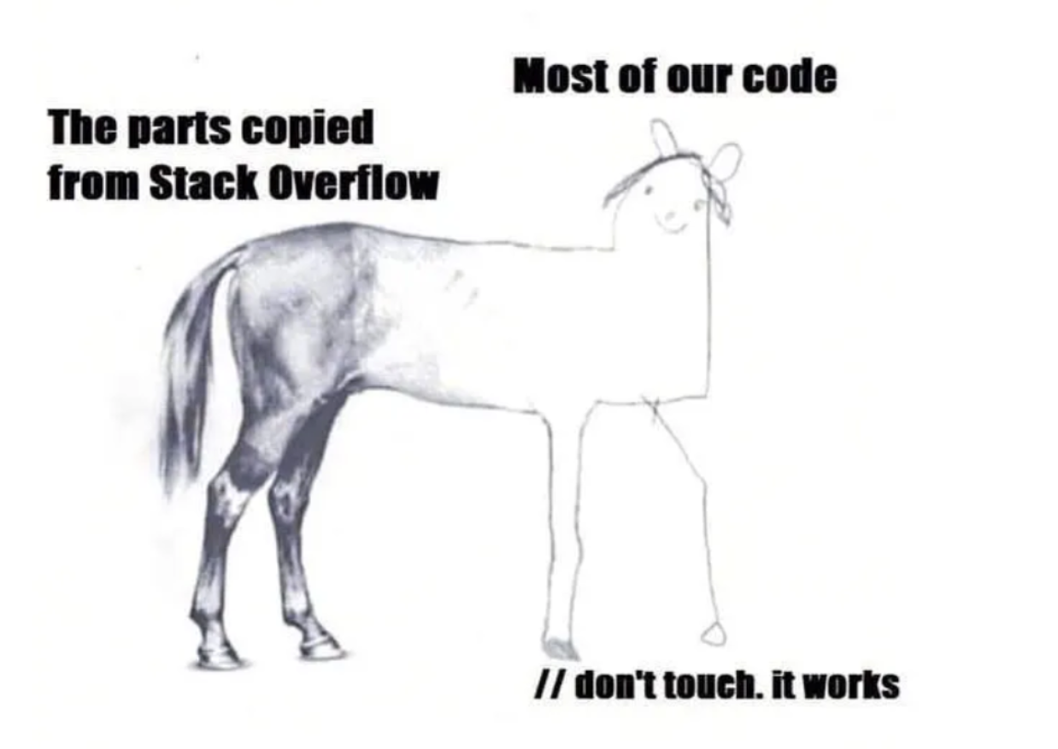
Good Luck with your Tasks ☺
ChatGPT
[https://python.plainenglish.io/20-funny-programming-memes-that-will-make-your-day-5793a8e1608b]

